Slide 1


Bank of Baroda Hackathon - 2022
Technology Partner
Your Team Name : REAL TIME SOLUTION PROVIDERS
Your team bio : 3 Team Members
Dr. Shweta Gupta ( Team Leader )
Varsshini R.
Taneeru Karthikeya
Date : 19-09-2022

Slide 2
Problem Statement?
Why did you decide to solve this Problem statement?
This problem statement comes from real life incident when my debit card was lost and inspite of informing Bank Manager of ICICI Bank , Kumarswamy Layout , Stage -2 Branch , someone after two days withdrew Rs. 40000 from the ATM.
Besides that, it is used to provide safety and security for ATM transactions in rural areas as well as urban areas and hence , safe money transactions at ATM and providing facility of different languages using video analytics.
Solution provided concentrates on tampering with camera, time taken for activity on premises and monitoring sentiments of customers for employee appraisal.

Slide 3
User Segment & Pain Points
Which user /advertiser segment would be early adopter of your product & why?
The bank segment will be the early adopter of our product because our products enables safe ATM transactions with face recognition, behaviour and subsequent alerts and providing services in various languages with back compatibility with latest technology incorporated.
Our product also makes sure to ensure the safety of the bank/atm. The bank also will use our product for better understanding of their clients as well as their feedbacks.

Slide 4
Pre-Requisite
What are the alternatives/competitive products for the problem you are solving?
They are competitive products such as face recognition and behavior recognition software.
We also use softwares that detect time delay.
But our software will be a modification of all such software to produce an all in one solution for the bank segment.

Slide 5
Azure tools or Resources
Azure tools or resources which are likely to be used by you for the prototype, if your idea gets selected ? Azure tools or resources which we would like to use : 1. Face Recognition or Computer Vision for Video Analytics Azure API 2. Decision Making Azure API 3. Web Search Azure API 4. Object Detection and Recognition Azure API 5. Sentiment Analysis Azure API ( for feedback to banks ) 6. Language Translation Azure API ( to assist all communities and uneducated class )

Slide 6
Any Supporting Functional Documents
Present your solution, talk about methodology, architecture & scalability
Our idea to solve this problem is coming out with a ATM machine with a
camera embedded in it.
This camera which is embedded in it will have all the photos of all the ATM card holder’s.
When a person goes to withdraw money from ATM, the camera will help us check whether ATM card which is inserted , is that of card holder’s or not .

Slide 7
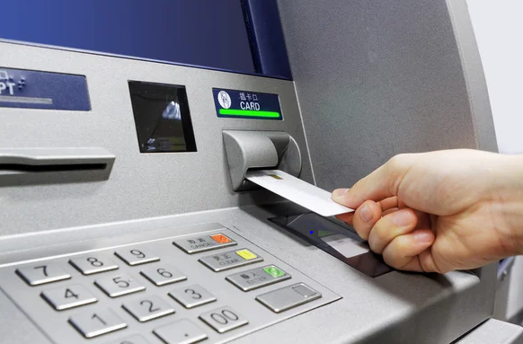
Any Supporting Functional Documents
Present your solution, talk about methodology, architecture & scalability
Special Features of our Solution :
If the card holder is only accessing the card then there won’t be any problem, otherwise if any other person is accessing ,then the software which we are going to install will send a message to the card holder for asking the permission.
The software which is designed by us also recognizes facial expressions which makes the above process very quick in helping the customers who are in emergency.
Also the software understands the facial expressions and gives the bank the correct feedback about their experience.

Slide 8
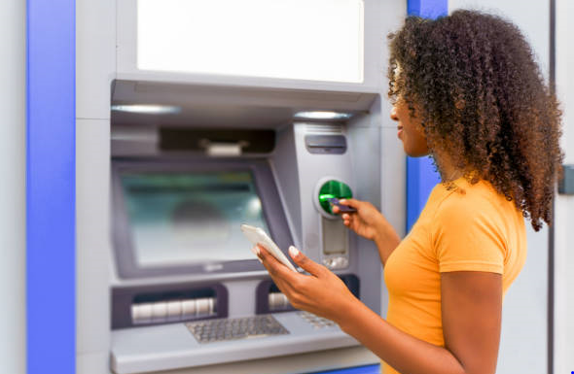
Any Supporting Functional Documents
Present your solution, talk about methodology, architecture & scalability
Special Features of our Solution :
Recognizing more than one person in the ATM camera, the pin will be disabled saying someone is peeping your pin.
If the person is seeing outside while inside the ATM, then we would also install one camera outside the ATM and take the video analytics of it also , so that if there is anything fishy it can be captured and analyzed and immediate alert can be sent to the bank for immediate action.

Slide 9
Any Supporting Functional Documents
Present your solution, talk about methodology, architecture & scalability
Special Features of our Solution :
Anyone standing ideally inside the ATM for a long time would be monitored, and immediate alert would be sent to bank by analyzing the time spent.
Objects nearing the cameras in the ATM would be monitored, to send immediate alert to the ATM.
Two people in close proximity would be monitored by using video analytics , and immediate alert would be sent to the bank.
Count of people would be monitored by video analytics at the ATM which would help for surveillance in rural areas.

Slide 10
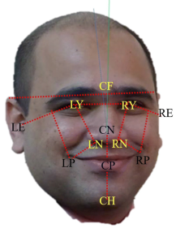
Any Supporting Functional Documents
Present your solution, talk about methodology, architecture & scalability
Special Features of our Solution :
Someone in a hurry should be monitored to give needed support if an emergency.
Someone looking for hidden cameras should be monitored by monitoring their eyeball movement by analyzing video analytics.
Cameras would also be installed also in the bank and ATM ‘s would also be monitoring facial expressions and hence, sentiments of customers to use it as feedback experience
with the bank.

Slide 11
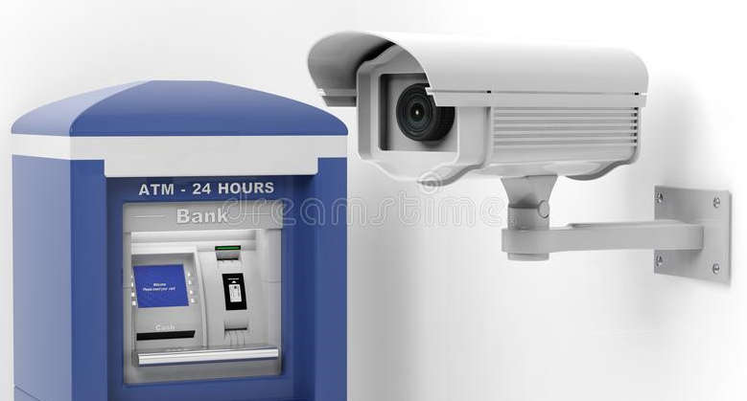
Key Differentiators & Adoption Plan
Present your solution, talk about methodology, architecture & scalability
Special Features of our Solution :
Till now , there were only cameras in ATM machine centers which will capture who is entering into the ATM.
But all the cameras which exist till today will only capture the back of the person who will enter into ATM’s.
One more difference is that till today there is no camera
which does this sort of job where you can
prevent the theft before it occurs.
Considering all the above points ,we propose our
idea as one of the solutions to avoid theft of money
through ATM cards at ATM centers.

Slide 12
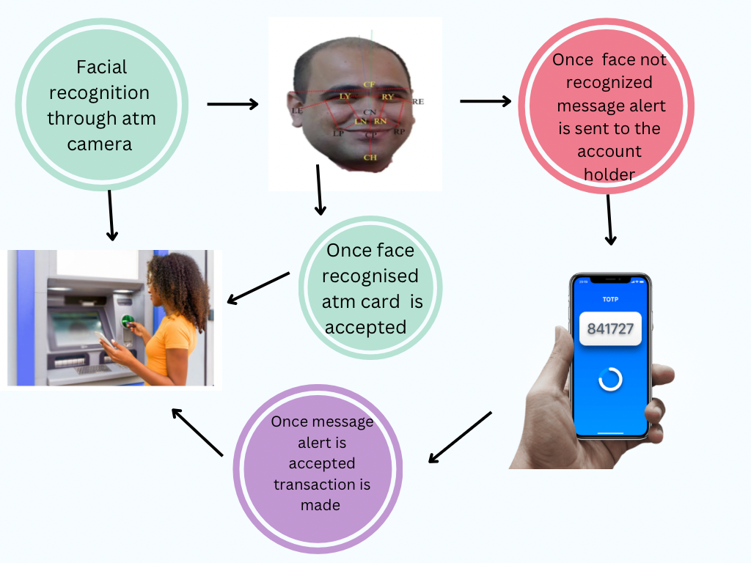
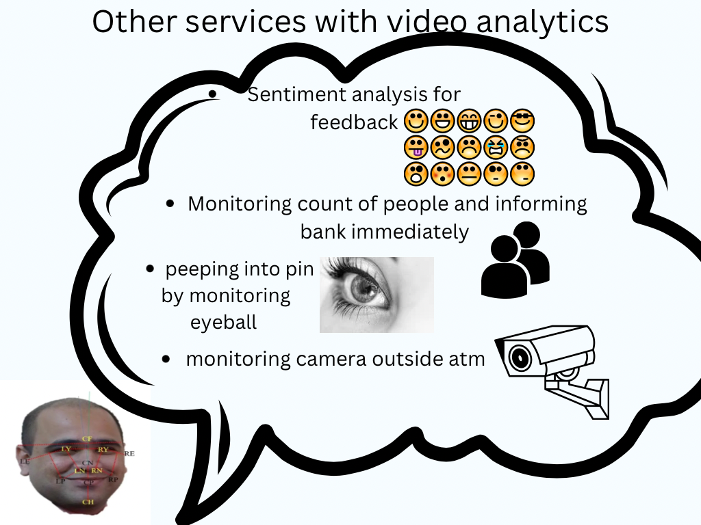
GitHub Repository Link & supporting diagrams, screenshots, if any
https://github.com/Varsshini321/REAL-TIME-SOLUTION-PROVIDERS

Slide 13
Thank You
Team member names

